Slide 1
Digital Portfolio
STUDENT NAME: Thiyagaraj S
REGISTER NO AND NMID: 222401235/asunm11024ai125
DEPARTMENT: B.sc(Computer science with Artificial intelligence)
COLLEGE: DRBCCC Hindu college/Madras university

Slide 2
PROJECT TITLE
Digital portfolio With My details

Slide 3


AGENDA
Problem Statement
Project Overview
End Users
Tools and Technologies
Portfolio design and Layout
Features and Functionality
Results and Screenshots
Conclusion
Github Link
3/21/2024 Annual Review

Slide 4

PROBLEM STATEMENT
In today’s world, students and freshers need a strong digital presence. A resume alone is not enough—having a clean and professional portfolio is essential for showcasing skills and projects effectively.

Slide 5

PROJECT OVERVIEW
This project is a personal portfolio website that highlights my skills, projects, education, and contact details. It is designed with a simple yet professional layout and is fully responsive, ensuring a smooth experience on both mobile and desktop devices.

Slide 6

WHO ARE THE END USERS?
The primary end users are recruiters, hiring managers, and professionals on platforms like LinkedIn. Additionally, peers and mentors can also access the site to provide feedback.

Slide 7

TOOLS AND TECHNIQUES
The website is built using HTML, CSS, and JavaScript. GitHub Pages or Netlify can be used for hosting. CSS Grid and Flexbox are applied to create a responsive and well-structured layout.

Slide 8
POTFOLIO DESIGN AND LAYOUT
The website consists of a hero section with name, photo, and tagline; a skills section displayed in grid-style cards; a projects section with hover effects; an education and contact section with clear formatting; and a footer for copyright. The design uses a dark header and a light body for contrast.
8

Slide 9
FEATURES AND FUNCTIONALITY
Smooth scroll navigation
Interactive project card click alerts Fully responsive design (mobile friendly)
Links to GitHub and LinkedInClean, minimalistic layout with hover effects

Slide 10
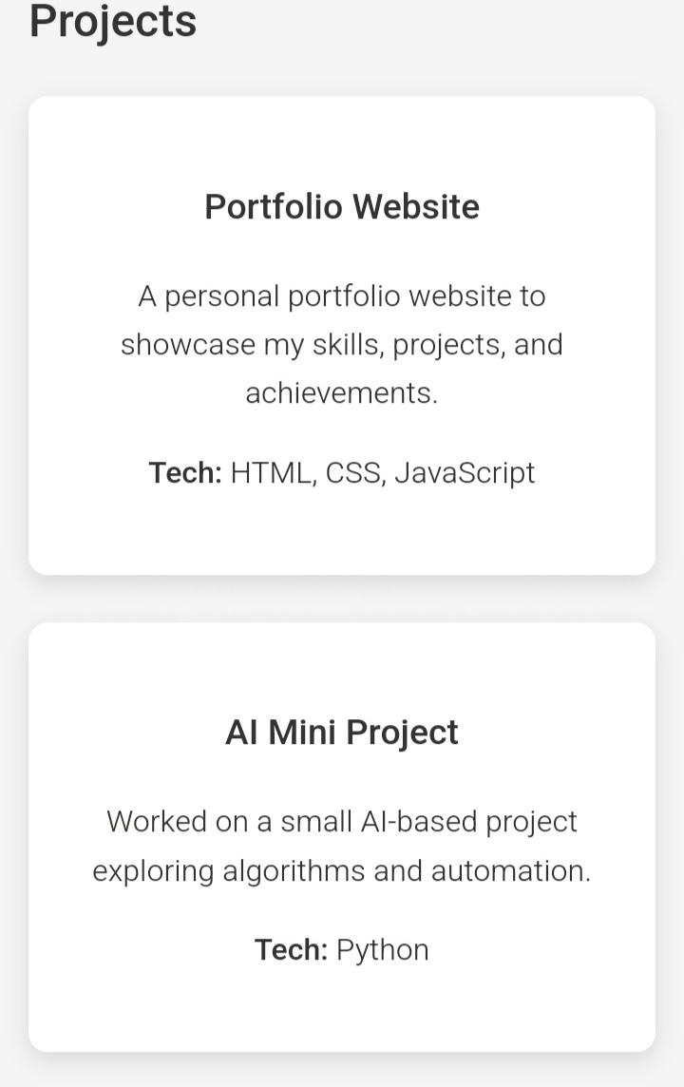
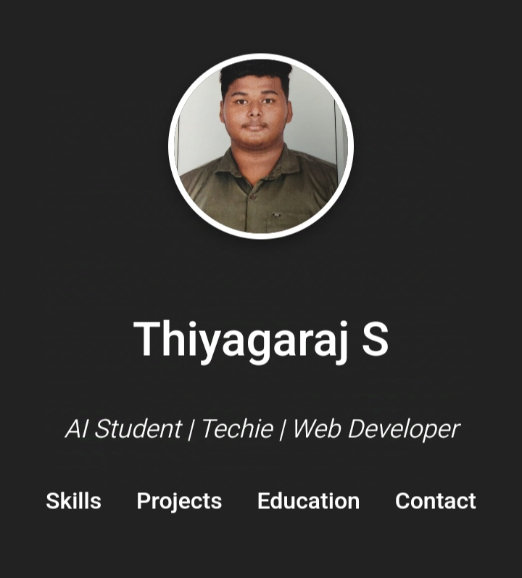
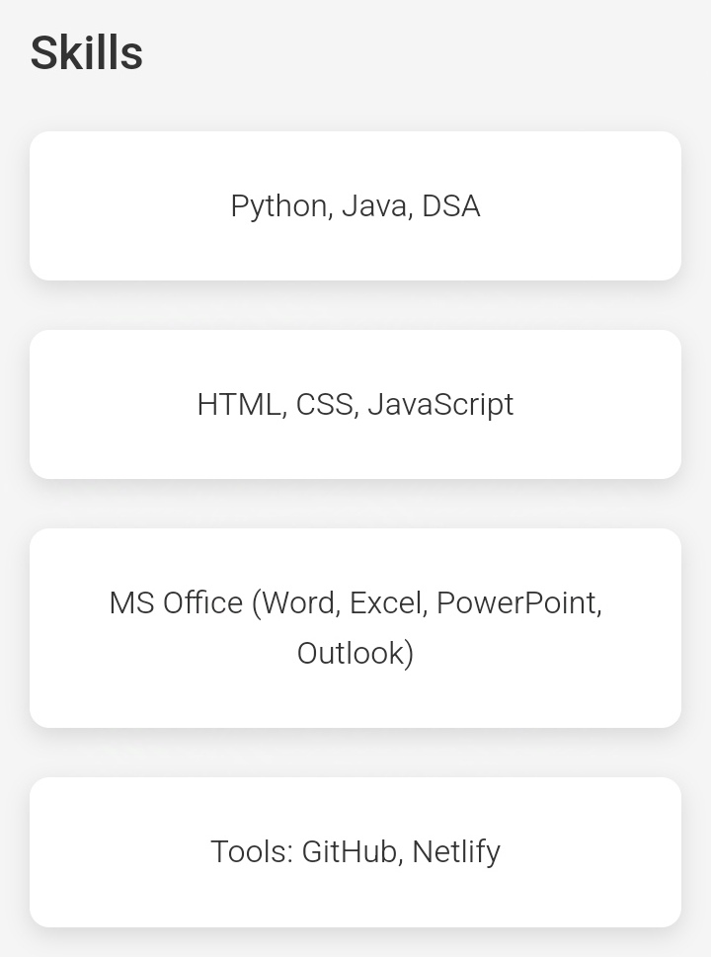
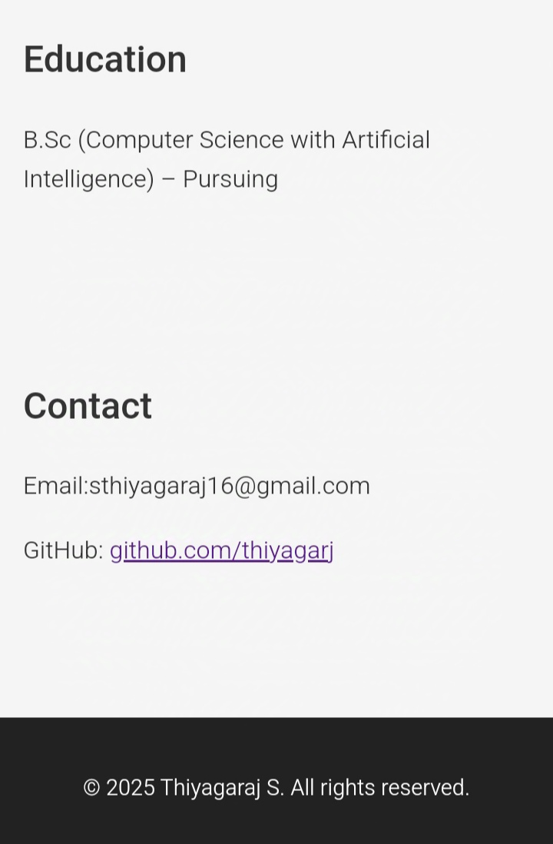
RESULTS AND SCREENSHOTS
3/21/2024 Annual Review
10

Slide 11
CONCLUSION
The portfolio website establishes a strong digital identity. Through this project, I practiced frontend development, responsive design, and basic interactivity. In the future, the site can be enhanced with backend integration for dynamic data.
11

